Slide 1
Spring Boot – Web Services
19-Apr-2017

Slide 2
Objective
Web Services Introduction
Types of Web Services
Creating Restful Web Services using Spring Boot
CRUD Operations and Annotation based Restful Web Service
SOAP Web Services
Creating SOAP based Web Service using Spring Boot
Notes:
Availability: Rolling out a new version of a microservice requires little downtime
Scalability: Each microservice can be scaled independently using pools, clusters, grids.
Time to Market: No dependency on other services. In monolithic approach, changing a component requires a thorough impact analysis and regression
Resiliency: Components are maintained and deployed independently. Each service can be developed independently and any failure in one app/service doesn’t affect other
Flexible Architecture: Application is broken down into multiple smaller services. Each maintained & deployed independently. Use Technology Stack based on Business function. Each service is independently maintained – Ability to leverage an emerging technical stack where ever required.

Slide 3
Web-services
• Web Services are software component which are available over internet
• WS are language neutral and platform neutral because of message is of type JSON / XML and transport is http (mostly)
• WS provides loose coupling between software components
• Web services provides re-usable software components
• Unlike client/server model, web-services does not participate in GUI model
• As described by the World Wide Web Consortium (W3C), web services provide a standard means of interoperating between software applications running on a variety of platforms and frameworks.

Slide 4
RESTful Web Services
REST stands for Representational State Transfer. It is an architectural style which can be used to design web services and allows user to access web-service over http protocol, that can be consumed from a variety of clients. The core idea is that, rather than using complex mechanisms such as CORBA, RPC or SOAP to connect between machines, simple HTTP is used to make calls among them.
In Rest based design, resources are being manipulated using a common set of verbs.
To Create a resource : HTTP POST should be used
To Retrieve a resource : HTTP GET should be used
To Update a resource : HTTP PUT should be used
To Delete a resource : HTTP DELETE should be used
That means, you as a REST service developer or Client, should comply to above criteria, in order to be REST complained.
Often Rest based Web services return JSON or XML as response, although it is not limited to these types only. Clients can specify (using HTTP Accept header) the resource type they are interested in, and server may return the resource , specifying Content-Type of the resource it is serving.

Slide 5
SpringBoot REST Api Example
Example for Restful services using SpringBoot application
1. Dependency Management [pom.xml]
<parent>
<groupId>org.springframework.boot</groupId>
<artifactId>spring-boot-starter-parent</artifactId>
<version>1.2.3.RELEASE</version>
</parent>
<dependencies>
<dependency>
<groupId>org.springframework.boot</groupId>
<artifactId>spring-boot-starter-web</artifactId>
</dependency>
<dependency>
<groupId>org.springframework.boot</groupId>
<artifactId>spring-boot-starter-data-mongodb</artifactId>
</dependency>
<dependency>
<groupId>org.springframework.boot</groupId>
<artifactId>spring-boot-starter-test</artifactId>
</dependency>
</dependencies>
3. REST Controller
Following is one possible Rest based controller, implementing REST API.
GET request to /api/user/ returns a list of users
GET request to /api/user/1 returns the user with ID 1
POST request to /api/user/ with a user object as JSON creates a new user
PUT request to /api/user/3 with a user object as JSON updates the user with ID 3
DELETE request to /api/user/4 deletes the user with ID 4
DELETE request to /api/user/ deletes all the users

Slide 6
SpringBoot REST Api Example
2. Main class [Application]
The @SpringBootApplication annotation is the starting point of Spring Boot application. We will initialize the application by calling the following line from our main method.
@SpringBootApplication
public class Application {
public static void main(String[] args) {
SpringApplication.run(Application.class, args);
}
}
3. Book object Model
To define the properties of the Book object and its corresponding getters/setters.
4. Book Repository
The interface of the Book Repository
.

Slide 7
RESTful Web Services
5. Controller
Following is one possible Rest based controller, implementing REST API
GET request to /book/getAllBooks returns a list of books
GET request to /book/getBook/1 returns the book with ID 1
POST request to /book/createBook/ with a book object as JSON creates a new book
PUT request to /book/editBook/3 with a book object as JSON updates the book with ID 3
DELETE request to /book/deleteBook/4 deletes the book with ID 4
The annotations used commonly in a controller:
@RestController : we are using Spring 4′s new @RestController annotation. This annotation eliminates the need of annotating each method with @ResponseBody. Under the hood, @RestController is itself annotated with @ResponseBody, and can be considered as combination of @Controller and @ResponseBody.
@RequestBody : If a method parameter is annotated with @RequestBody, Spring will bind the incoming HTTP request body(for the URL mentioned in @RequestMapping for that method) to that parameter. While doing that, Spring will [behind the scenes] use HTTP Message converters to convert the HTTP request body into domain object [deserialize request body to domain object], based on ACCEPT or Content-Type header present in request.

Slide 8
@ResponseBody : If a method is annotated with @ResponseBody, Spring will bind the return value to outgoing HTTP response body. While doing that, Spring will [behind the scenes] use HTTP Message converters to convert the return value to HTTP response body [serialize the object to response body], based on Content-Type present in request HTTP header. As already mentioned, in Spring 4, you may stop using this annotation.
ResponseEntity is a real deal. It represents the entire HTTP response. Good thing about it is that you can control anything that goes into it. You can specify status code, headers, and body. It comes with several constructors to carry the information you want to sent in HTTP Response.
@PathVariable This annotation indicates that a method parameter should be bound to a URI template variable [the one in '{}'].
Basically, @RestController , @RequestBody, ResponseEntity & @PathVariable are all you need to know to implement a REST API in Spring. Additionally, spring provides several support classes to help you implement something customized.

Slide 9
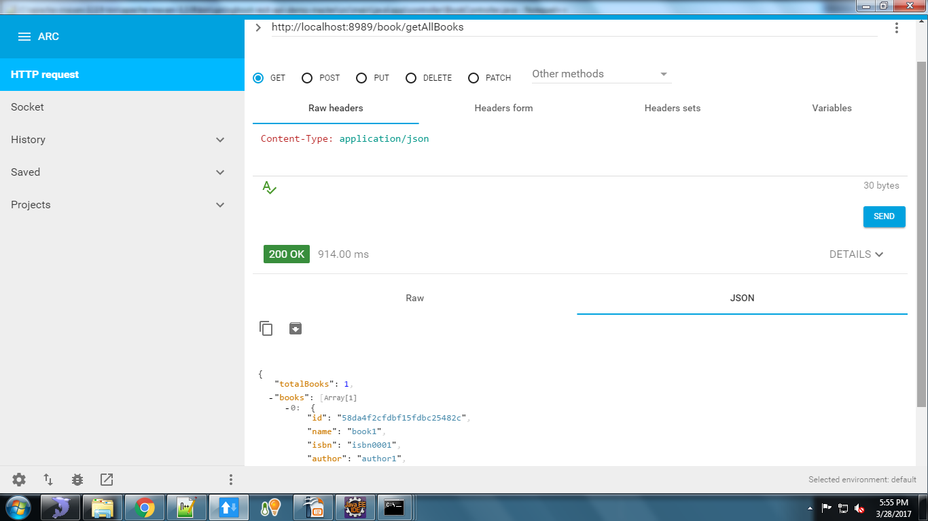
NoSql(Mongo) Get Service O/P

Slide 10
Different Database support
Working with SQL databases
The Spring Framework provides extensive support for working with SQL databases. From direct JDBC access using JdbcTemplate to complete ‘object relational mapping’ technologies such as Hibernate. Spring Data provides an additional level of functionality, creating Repository implementations directly from interfaces and using conventions to generate queries from your method names.
Configure a DataSource
Spring Boot can auto-configure embedded H2, HSQL and Derby databases. You don’t need to provide any connection URLs, simply include a build dependency to the embedded database that you want to use.
POM dependencies would be:
<dependency>
<groupId>org.springframework.boot</groupId>
<artifactId>spring-boot-starter-data-jpa</artifactId>
</dependency>
<dependency>
<groupId>org.hsqldb</groupId>
<artifactId>hsqldb</artifactId>
<scope>runtime</scope>
</dependency>

Slide 11
Different Database support
Connection to a JNDI DataSource
If you are deploying your Spring Boot application to an Application Server you might want to configure and manage your DataSource using your Application Servers built-in features and access it using JNDI.
The spring.datasource.jndi-name property can be used as an alternative to the spring.datasource.url, spring.datasource.username and spring.datasource.password properties to access the DataSource from a specific JNDI location. For example, the following section in application.properties shows how you can access a JBoss AS defined DataSource:
spring.datasource.jndi-name=java:jboss/datasources/customers
Using JdbcTemplate
Spring’s JdbcTemplate and NamedParameterJdbcTemplate classes are auto-configured and you can @Autowire them directly into your own beans

Slide 12
Sample Rest Service with MySql as DB
Sample Rest Service with MySql as DB
The following properties are need to configure MySQL with Spring Boot. You can see these are pretty standard Java data source properties.
spring.datasource.url= jdbc:mysql://localhost:3306/check
spring.datasource.username=root
spring.datasource.password=
Dependencies used:
springbootstarterjdbc – This spring boot provided starter is responsible for support to connect and use JDBC databases, and other JDBC related services like connection pools etc.
springbootstarterdata-jpa – This is again spring boot provided JPA starter that provides the dependent libraries related to Java Persistence API, the JPA provider like Hibernate.
mysql-connector-java – MySQL java driver
We need >mysql-connector-java only at runtime so its scope can be set to runtime. This is because DataSource object provides abstraction to underlying datasource so we don’t really need the database driver at compile time

Slide 13
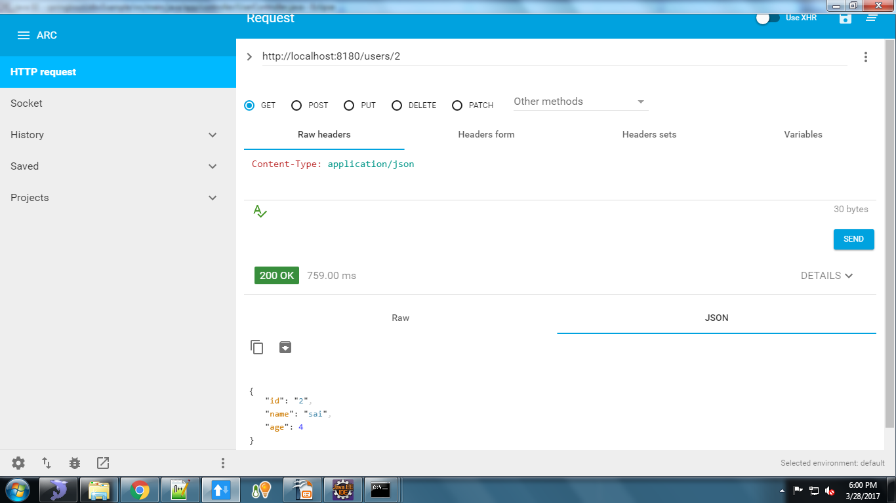
MySql Get Service O/P

Slide 14
Spring Data Introduction
Spring Data is a high level project developed by Spring community aimed at simplifying the data access operations for the applications. There are several sub-projects maintained for the individual storesÂ to have its own implementation of repositories.
If you are using Spring Data in your project, you are not going to write most of the low level data access operations like writing SQL query, DAO classes, Â etc. Spring Data will generate everything dynamically at run-time by creating the proxy instances of your abstract repositories and perform the required operations. What you write is the abstract interfaces that define the required operations.
The commonly used sub project is Spring Data JPA. Other than that Spring Data has the following sub-projects:
Spring Data Commons, Spring Data MongoDB, Spring Data Redis, Spring Data Solr, Spring Data Gemfire, Spring Data REST, Spring Data Neo4j
Spring Data JPA, it is part of the Spring Data family, aims to provide the JPA based repositories that aims to simplify the implementation of data access layer using JPA.
spring-boot-starter-parent loads all the default configurations required for the basic spring boot applications.
spring-boot-starter-data-jpa dependency will download the files required for spring data jpa.
spring-boot-starter-webis required because it is web based application to expose the REST endpoints.
The above configurations sufficient to get started developing our simple REST APIs application using Spring Data JPA.

Slide 15
Spring Data Repositories
When you are working with spring data technologies, it is important to understand the repositories concept. Spring data provides the abstract repositories, that are implemented at run-time by the spring container and perform the CRUD operations. As a developer we have to just provide the abstract methods in the interface. This reduces the amount of boilerplate code required to write data access layers.
The following are the three base interfaces defined in the spring data commons project.
Repository
It is the central interface in the spring data repository abstraction. This is a marker interface. If you are extending this interface, you have to declare your own methods and the implementations will be provided by the spring run-time. For this interface also we have to pass two parameters:type of the entity and type of the entity’s id field.Â This is the super interface for CrudRepository.
CrudRepository
CrudRepository provides methods for the CRUD operations. This interface extends the Repository interface. When you define CrudRepository, you have to pass the two parameters: type of the entity and type of the entity’s id field. This interface has the following methods: T findOne(ID primaryKey), Iterable findAll(), Long count(), void delete(T entity), boolean exists(ID primaryKey)
If you are extending the CrudRepository, there is no need for implementing your own methods. Just extend this interface and leave it as blank. Required implementations are provide at run time.

Slide 16
JPA Vs CRUD Repository
Both, JpaRepository and CrudRepository are base interfaces in Spring Data. Application developer has to choose any of the base interfaces for your own repository. It has two purposes,
One is to allow spring data to create proxy instance for your repository interface.
Second one is to inherit the maximum default functionality from the base interfaces without declaring your own methods.
When we look at both of the interfaces, the clear differences are:
CrudRepository is part of Spring Data Commons project and declared under the package org.springframework.data.repository. Where as JpaRepository is part of store specific implementation and declared under the package org.springframework.data.jpa.repository.
CrudeRepository extnds from Repository interface. Where as JpaRepository extends from PagingAndSortingRepository which inturen extends from the CrudeRepository.
JpaRepository returns List type of entities and CrudRepository returns Iterable type of entities.
It is general recommendation that not to use the store specific base interfaces as they expose the underlying persistence technology and tighten the coupling between them and the repository. It is always good idea to choose any of the generic base interfaces like CrudRepository or PagingAndSortungRepository.

Slide 17
Thank You !!

